Slide 1

ECE382
Lesson 35
1

Slide 2
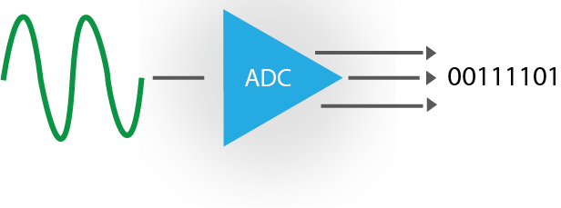
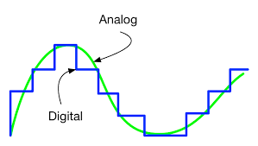
Overview
Lesson Outline
Analog to Digital Converter (ADC)
Discrete signal out (data is parallel)
Continuous signal in
Note how the digital representation isn’t a perfect copy of the analog signal

Slide 3
Lesson Outcomes
Advantages/disadvantages of digital signals
Understand the following parameters and impacts in ADC systems:
Sampling rate, voltage range, bits, and resolution
Understand the 3 steps of ADC process
Understand the 3 common ADC errors
Understand how to use the ADC on the MSP430

Slide 4
BLUF
3 steps in the Analog to Digital Conversion (ADC) Process:
Sample (snapshot in time)
Quantize (assign voltage level)
Encode (convert to bits)
Sampling (time) and Resolution (voltage) are independent

Slide 5
More BLUF
3 errors in the Analog to Digital Conversion (ADC) Process:
Aliasing (due to inadequate sampling rate)
Clipping (voltage exceeds input range of ADC)
Quantization error (inherent – can only be minimized)

Slide 6
Digital vs Analog
What’s the difference?
What are the advantages?
Disadvantages?

Slide 7
Analog vs Digital
Analog
Digital
Information represented by a continuously variable physical quantity
No discontinuities in time or amplitude
Information represented by discrete valued variables
Time axis is sampled
Amplitude axis is quantized

Slide 8
Digital Signals
Advantages
Disadvantages
Noise resistant
Easy to store and recover data
Easy to encrypt and process data
Lost data (important?)
Sampling errors may exist – aliasing
Quantization errors always exist

Slide 9
ADC
How does Analog to Digital Conversion Happen?
Sampling: Snapshots at discrete times (Nyquist rate)(x-axis)
Quantization: Round to discrete voltage levels (resolution)(y-axis)
Encoding: convert decimal levels to binary (convert to bits)
Encode in 5 bits: 10011
D
Digital
Analog
Resolution
Sampling
What does the computer assume between samples?

Slide 10
Key Definitions
Sampling:
Taking measurements of a continuous time signal at discrete time instances
Time axis
Quantization
Assigning sampled measurements values from a discrete set of allowable values
Amplitude axis
Encoding
Convert a quantized measurement to a binary string

Slide 11
How does Analog to Digital Conversion Happen?
Sampling: Snapshots at discrete times
Quantization: Round to discrete voltage levels
Encoding: convert decimal levels to binary

Slide 12
Sampling
What is your class score right now?
At Prog?
At Final?
An example sampling rate could be every 5 lessons

Slide 13
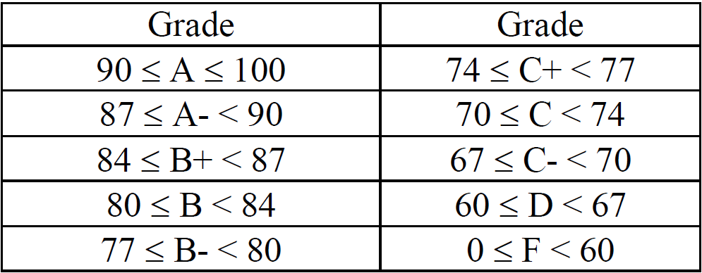
Quantize into discrete grade levels

Slide 14
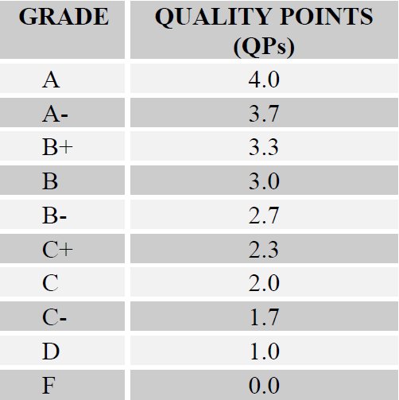
Encoding Grade Levels into decimal

Slide 15
3 Steps of the
ADC Process?
ADC – The device

Slide 16
Analog Signal

Slide 17
1) Sample at uniform intervals
Capture Voltages at
Sampled “snapshots”
T_{s} = 1/f_{s}
0
T_{s}
2T_{s}
3T_{s}
Potential Error:
Changes between samples

Slide 18
2) Quantize into discrete voltage levels
Introduces
Quantization
Error
7
6
5
4
3
2
1
0

Slide 19
3) Encode Levels as Binary
7
6
5
011
001
000
001
010
011
4
110
111
111
110
101
3
2
1
0

Slide 20
Reconstruction from bits

Slide 21
DAC Output = Digital!
5V
0V

Slide 22
Reform smooth signal

Slide 23
Compare

Slide 24
ADC – The device

Slide 25
Quantization Definitions
V_{max}: Largest input that can be correctly converted
V_{min}: Smallest input that can be correctly converted
b: Number of binary bits that will be used to encode data
Quantization levels: 2^{b}
Resolution: Smallest signal change that can be measured by A/D conversion
$∆V= \frac{V_{max}−V_{min}}{2^{b}}$
Important Note: Quantization (y-axis) and sampling (x-axis) are independent processes

Slide 26
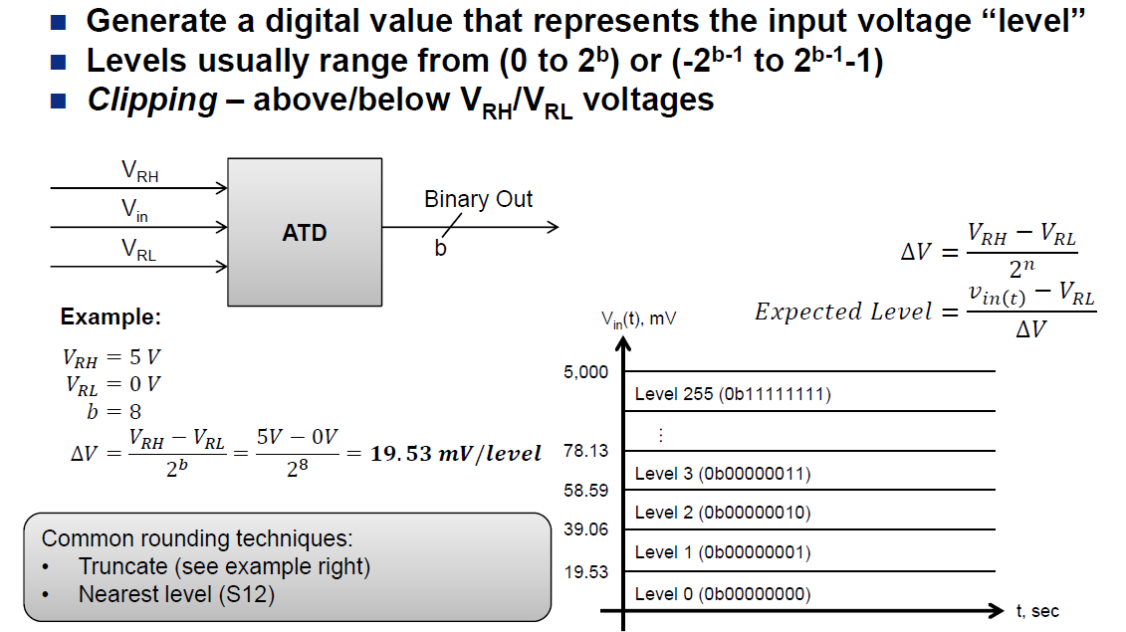

Slide 27
Sampling frequency trade-offs
Sample too slow
Aliasing
Sample too fast???
Hardware limitations
max sampling rate of Real-time signal
Available memory
More processor time
More storage space

Slide 28
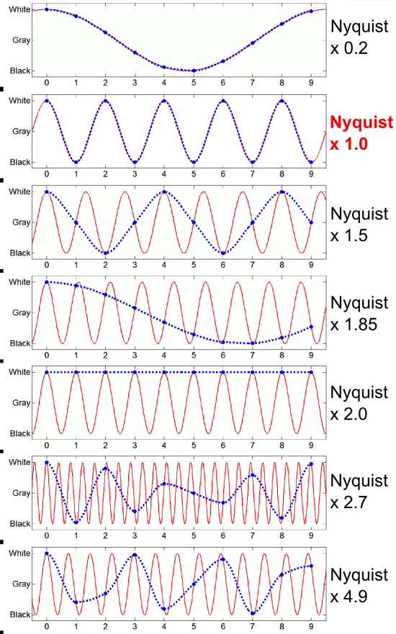
Nyquist (Sampling)
fs=5N
fs=N
Nyquist frequency:
f_{s} >= 2f_{high}
Where f_{high} is the highest frequency being sampled
fs=2/3N
fs=.54N
fs=1/2N
fs=1/3N
Look closely, the wheel appears to be moving in reverse … the camera isn’t capturing fast enough to record the motion correctly!
fs=1/5N

Slide 29
Aliasing Examples
https://www.youtube.com/watch?v=CaiIZI1oe40
https://www.youtube.com/watch?v=smDpCsVVgPA

Slide 30
Aliasing
Sampling exactly in step with blade rotation
Car wheels going backward on TV
Must sample “fast enough” to avoid this

Slide 31
Nyquist Sampling Rate f_{N} = 2 * f_{high}
To avoid aliasing
f_{sample} > 2 * f_{high}
http://www.kostic.niu.edu/aliasing-movie.gif

Slide 32
Quantize into discrete voltage levels
V_{MAX}
7
Introduces
Quantization
Error
6
5
4
3
2
1
V_{MIN}
0

Slide 33
Key Points
Resolution is determined by the Analog to Digital Converter (ADC) not the input signal
Smaller resolution is generally better
Resolution units are volts/level
Quantization throws away data and therefore induces error
Max quantization error is equal to resolution
Quantization “Clips” any values outside V_{min} & V_{max}
How can we avoid clipping? Transducer interface

Slide 34
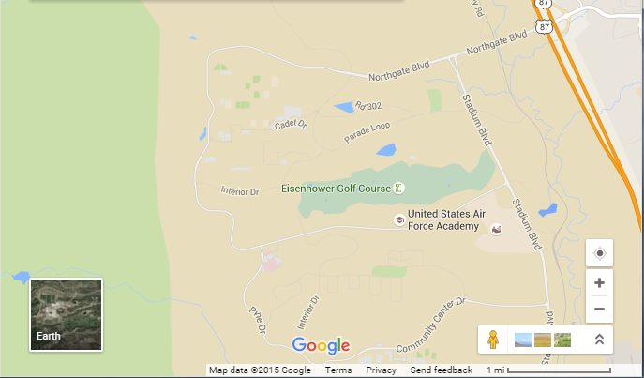
Resolution Tradeoff Example

Slide 35
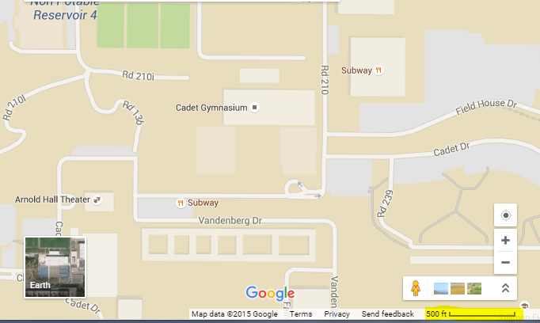
Smaller Resolution = More Details

Slide 36

Given: v_{in}(t) = 4 + 4 cos (360◦ 2k t) V, $∆V=200mV/level$ or better
Find: Appropriate ADC Parameters and resultant QE_{MAX}
Notes:
Time between samples: 100 usec
1st sample: 500 mV
2nd sample: -154.5 mV
Resolution = 250 mV/level
EL1 = 6
EL2 = 3.382
QL1 = 6 → Binary output = 110
QL2 = 3 → Binary output = 011

Slide 37
Given: v_{in}(t) = 50 cos (360◦ 3k t) mV What are the issues here? How would you fix it?
Notes:
Time between samples: 100 usec
1st sample: 500 mV
2nd sample: -154.5 mV
Resolution = 250 mV/level
EL1 = 6
EL2 = 3.382
QL1 = 6 → Binary output = 110
QL2 = 3 → Binary output = 011

Slide 38
Given: v_{in}(t) = 50 cos (360◦ 3k t) mV What are the issues here? How would you fix it?
Notes:
Time between samples: 100 usec
1st sample: 500 mV
2nd sample: -154.5 mV
Resolution = 250 mV/level
EL1 = 6
EL2 = 3.382
QL1 = 6 → Binary output = 110
QL2 = 3 → Binary output = 011

Slide 39

Analog to Digi Errors??
Notes:
Name 3 types of errors (aliasing, clipping, and Q.E.)

Slide 40
Analog to Digi Errors??
3 errors in the Analog to Digital Conversion (ADC) Process:
Aliasing (due to inadequate sampling rate)
Clipping (voltage exceeds input range of ADC)
Quantization error (inherent – can only be minimized)

Slide 41
Signal Conditioning
How do you prevent aliasing when using ADC?
Anti-Aliasing filter!
How can we minimize Q.E.? Prevent Clipping?
Fit the signal to the window
True or False?
Quantization error can be eliminated

Slide 42
Anti-Aliasing filter to the rescue!
Given: v_{in}(t) = 50 cos (360◦ 3k t) mV How to prevent aliasing???
Notes:
Time between samples: 100 usec
1st sample: 500 mV
2nd sample: -154.5 mV
Resolution = 250 mV/level
EL1 = 6
EL2 = 3.382
QL1 = 6 → Binary output = 110
QL2 = 3 → Binary output = 011

Slide 43
Lesson 36 TI Example code
// TI example code
#include <msp430g2553.h>
void main(void)
{
WDTCTL = WDTPW + WDTHOLD; // Stop WDT
ADC10CTL0 = ADC10SHT_3 + ADC10ON + ADC10IE; // ADC10ON, interrupt enabled
ADC10CTL1 = INCH_4; // input A4
ADC10AE0 |= BIT4; // P1.4 ADC Analog enable
ADC10CTL1 |= ADC10SSEL1|ADC10SSEL0; // Select SMCLK
P1DIR |= 0x01; // Set P1.0 to output direction
while (1)
{
ADC10CTL0 |= ENC + ADC10SC; // Sampling and conversion start
__bis_SR_register(CPUOFF + GIE); // LPM0, ADC10_ISR will force exit
if (ADC10MEM < 0x1FF)
P1OUT &= ~0x01; // Clear P1.0 LED off
else
P1OUT |= 0x01; // Set P1.0 LED on
}
}
// ADC10 interrupt service routine
#pragma vector=ADC10_VECTOR
__interrupt void ADC10_ISR(void)
{
__bic_SR_register_on_exit(CPUOFF); // Clear CPUOFF bit from 0(SR)
}
Setup
Sample, Quantize, and Encode
Read Encoded Value

Slide 44
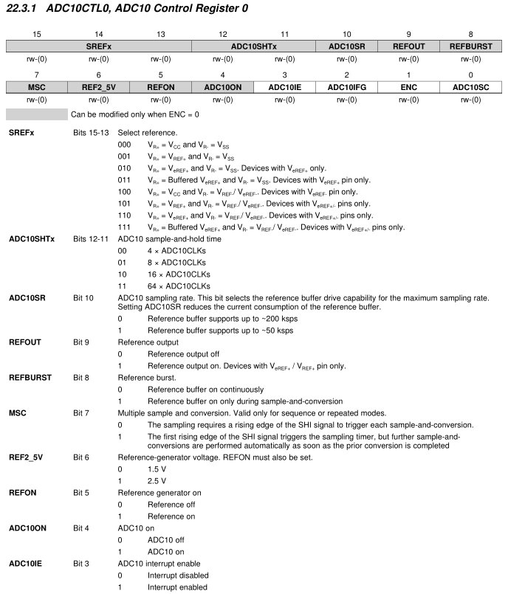
ADC10CTL0 Register
ADC10CTL0 = ADC10SHT_3 + ADC10ON + ADC10IE; // ADC10ON, interrupt enabled
ADC10CTL1 = INCH_4; // input A4
ADC10AE0 |= BIT4; // P1.4 ADC Analog enable
ADC10CTL1 |= ADC10SSEL1|ADC10SSEL0; // Select SMCLK
P1DIR |= 0x01; // Set P1.0 to output direction

Slide 45
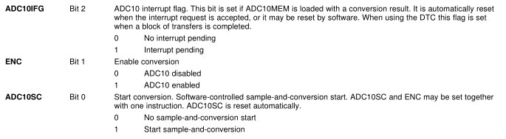
ADC10CTL0 Register Cont.

Slide 46
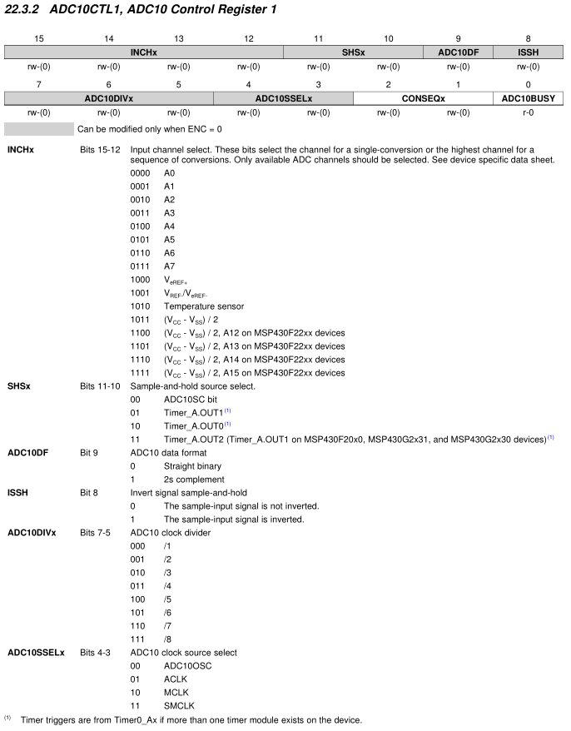
ADC10CTL1 Register
ADC10CTL0 = ADC10SHT_3 + ADC10ON + ADC10IE; // ADC10ON, interrupt enabled
ADC10CTL1 = INCH_4; // input A4
ADC10AE0 |= BIT4; // P1.4 ADC Analog enable
ADC10CTL1 |= ADC10SSEL1|ADC10SSEL0; // Select SMCLK
P1DIR |= 0x01; // Set P1.0 to output direction

Slide 47
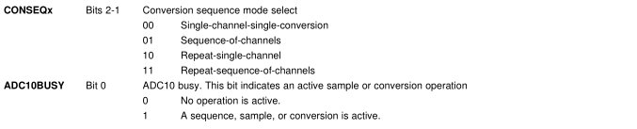
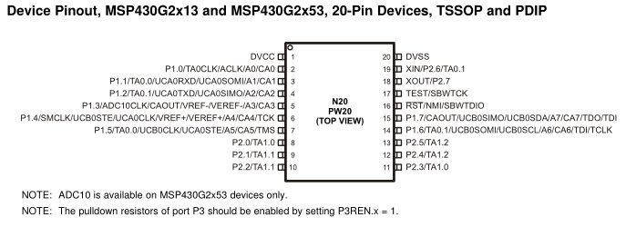
ADC10CTL1 Register Cont.
Note:
Port 1: analog muxed
Port 2: timer muxed

Slide 48
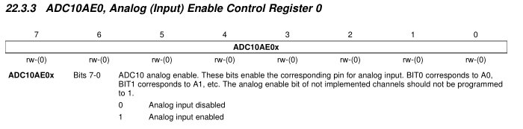
ADC10AE0 Register
ADC10CTL0 = ADC10SHT_3 + ADC10ON + ADC10IE; // ADC10ON, interrupt enabled
ADC10CTL1 = INCH_4; // input A4
ADC10AE0 |= BIT4; // P1.4 ADC Analog enable
ADC10CTL1 |= ADC10SSEL1|ADC10SSEL0; // Select SMCLK
P1DIR |= 0x01; // Set P1.0 to output direction

Slide 49
ADC10CTL1 Register
ADC10CTL0 = ADC10SHT_3 + ADC10ON + ADC10IE; // ADC10ON, interrupt enabled
ADC10CTL1 = INCH_4; // input A4
ADC10AE0 |= BIT4; // P1.4 ADC Analog enable
ADC10CTL1 |= ADC10SSEL1|ADC10SSEL0; // Select SMCLK
P1DIR |= 0x01; // Set P1.0 to output direction

Slide 50
While Loop (Sample, Quantize, & Encode)
while (1)
{
ADC10CTL0 |= ENC + ADC10SC; // Sampling and conversion start
__bis_SR_register(CPUOFF + GIE); // LPM0, ADC10_ISR will force exit
if (ADC10MEM < 0x1FF)
P1OUT &= ~0x01; // Clear P1.0 LED off
else
P1OUT |= 0x01; // Set P1.0 LED on
}
}
// ADC10 interrupt service routine
#pragma vector=ADC10_VECTOR
__interrupt void ADC10_ISR(void)
{
__bic_SR_register_on_exit(CPUOFF); // Clear CPUOFF bit from 0(SR)
}

Slide 51
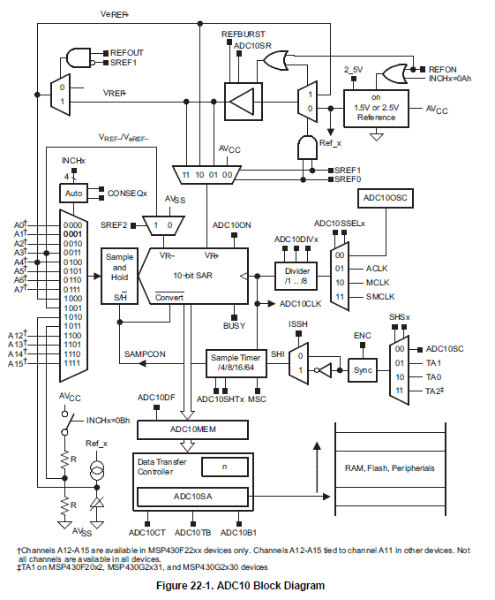
ADC10 Block Diagram

Slide 52
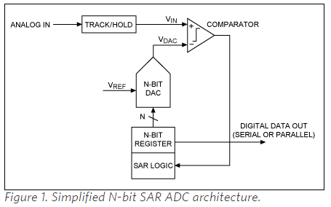
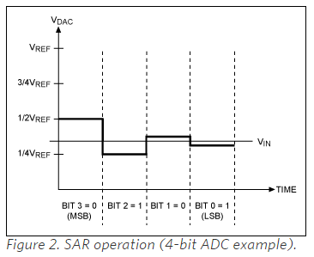
Successive-approximation-register(SAR)
https://www.maximintegrated.com/en/app-notes/index.mvp/id/1080
As the name implies, the SAR ADC basically implements a binary search algorithm. Therefore, while the internal circuitry may be running at several megahertz (MHz), the ADC sample rate is a fraction of that number due to the successive-approximation algorithm.

Slide 53
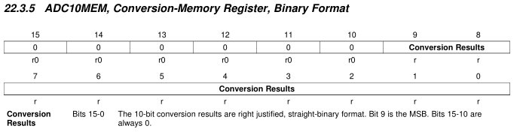
While Loop (Disable CPU for Low Power)
while (1)
{
ADC10CTL0 |= ENC + ADC10SC; // Sampling and conversion start
__bis_SR_register(CPUOFF + GIE); // LPM0, ADC10_ISR will force exit
if (ADC10MEM < 0x1FF)
P1OUT &= ~0x01; // Clear P1.0 LED off
else
P1OUT |= 0x01; // Set P1.0 LED on
}
}
// ADC10 interrupt service routine
#pragma vector=ADC10_VECTOR
__interrupt void ADC10_ISR(void)
{
__bic_SR_register_on_exit(CPUOFF); // Clear CPUOFF bit from 0(SR)
}
10b
How many bits?
What is the max value?
0x3FF

Slide 54
While Loop (Read Encoded Input Memory)
while (1)
{
ADC10CTL0 |= ENC + ADC10SC; // Sampling and conversion start
__bis_SR_register(CPUOFF + GIE); // LPM0, ADC10_ISR will force exit
if (ADC10MEM < 0x1FF)
P1OUT &= ~0x01; // Clear P1.0 LED off
else
P1OUT |= 0x01; // Set P1.0 LED on
}
}
// ADC10 interrupt service routine
#pragma vector=ADC10_VECTOR
__interrupt void ADC10_ISR(void)
{
__bic_SR_register_on_exit(CPUOFF); // Clear CPUOFF bit from 0(SR)
}

Slide 55
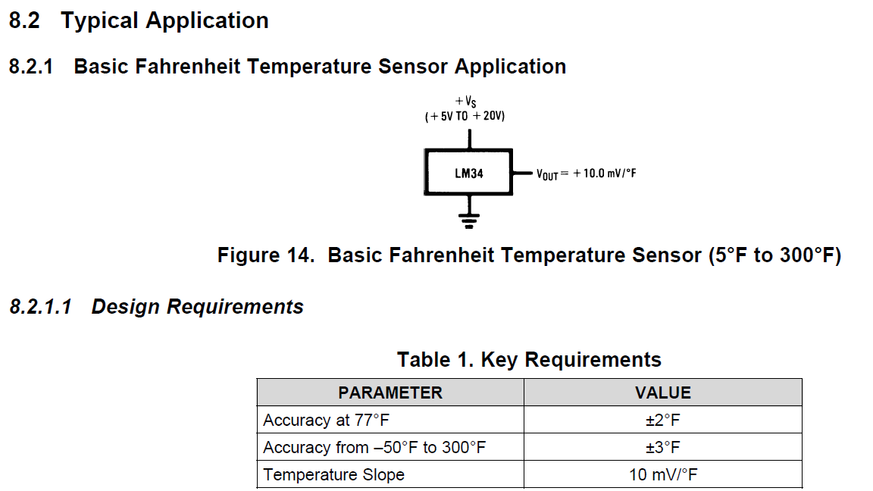
LM34 Temperature Sensor

Slide 56
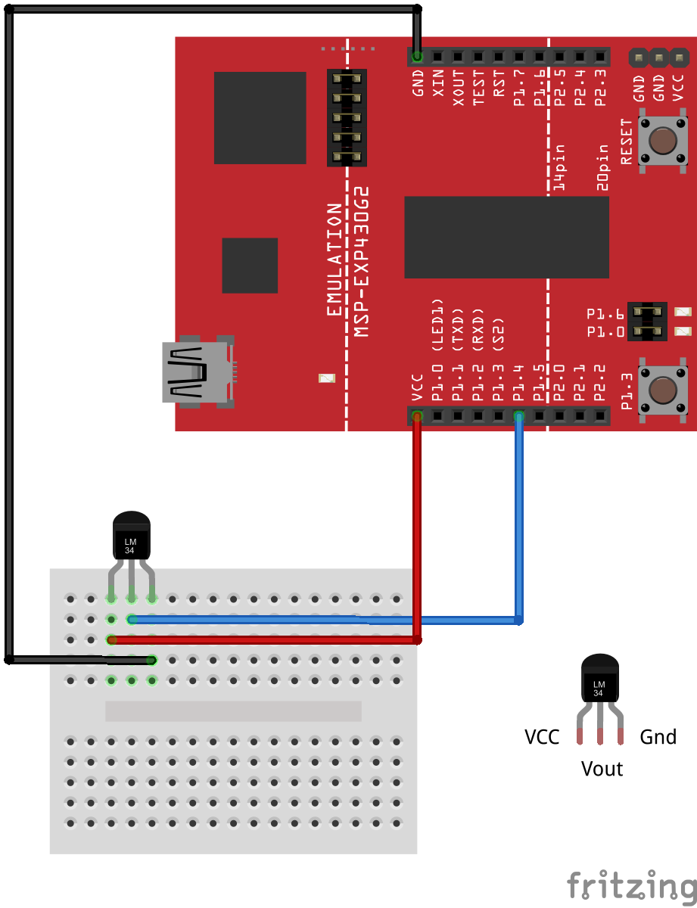
ADC Temperature Schematic

Slide 57
Changes to ADC10CTL0 Register for LM34
ADC10CTL0 |= SREF_1 | ADC10SHT_3 | ADC10ON | REFON | ADC10IE; // ADC10ON, interrupt enabled

Slide 58
ADC10CTL1 Register
ADC10CTL1 |= INCH_4 | ADC10DIV_7; // input ch A4, Div by 8

Slide 59

ADC
1.5V=
0V=

Slide 60
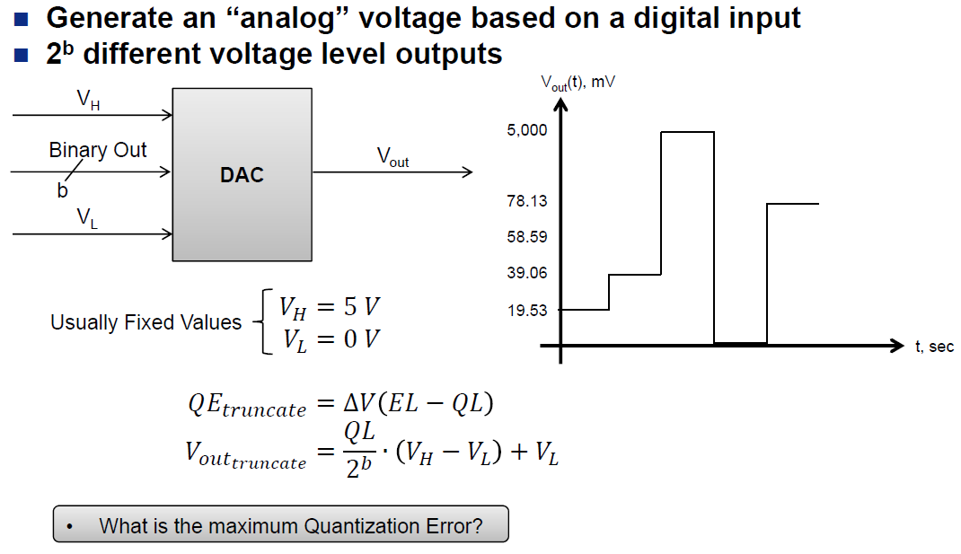
DAC

Slide 61
BACKUPS

